Slide 1
Transfer Learning in NLP
Word Embeddings. BERT
SPBU, Spring 2025
Petrova Alisa

Slide 2
Outline
Word Embeddings
Word2Vec
GloVe
FastText
GPT
Masked Language Modeling
BERT
Coding part

Slide 3
Recall: one-hot encoding
One-hot vectors of dictionary size (ex. 500,000)
mother = [0…0, 1, 0...0]
cat = [1, 0...0]

Slide 4
Recall: one-hot encoding
One-hot vectors of dictionary size (ex. 500,000)
mother = [0…0, 1, 0...0]
cat = [1, 0...0]
Problems:
vectors do not contain meaning
no similarity measure between vectors

Slide 5
Recall: context embedding
v(word_i)[ j ] = count(co-occurrences word_i with word_j)
[12, 1, 2, 0, 5,…]
Example: v(word) = [12,1,2,0,5,...]
[5, 5, 4, 3,…]
Dimensional reduction
v(word) =

Slide 6
Recall: context embedding
Problems:
rare words
huge computational time
when you change your dataset you need to recompute everything

Slide 7
Recall: latent semantic analysis
document
d
SVD
≈
✕
✕
w
word
We can compute similarity with cosine metric.

Slide 8
Recall: latent semantic analysis
We get small-dimensional vectors
Vectors contain meanings of words
We can compute distance between words (cosine distance)

Slide 9
Recall: latent semantic analysis
We get small-dimensional vectors
Vectors contain meanings of words
We can compute distance between words (cosine distance)
Problems:
huge computational time
when you change your dataset you need to recompute everything

Slide 10
Still what we did is we created some matrix of word representations and then computed word vectors using dimensionality reduction methods
But how about to learn those word representations?

Slide 11
What we want:
We want to learn dense vectors for words and we want this vectors to have distance (word vector should be close to vectors of other words that often appear in same context)
Those learned word vectors are called word embeddings

Slide 12
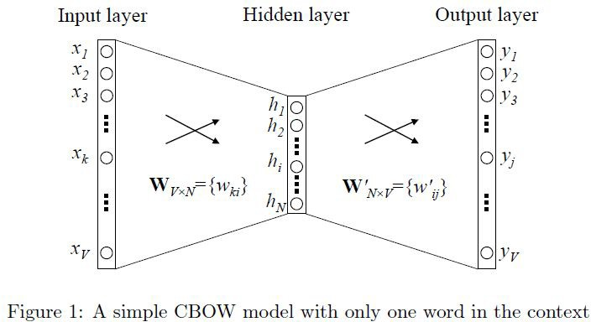
Word2Vec
Predict context words given a word (or vice versa)
maximize probability of seeing word and its context together

Slide 13
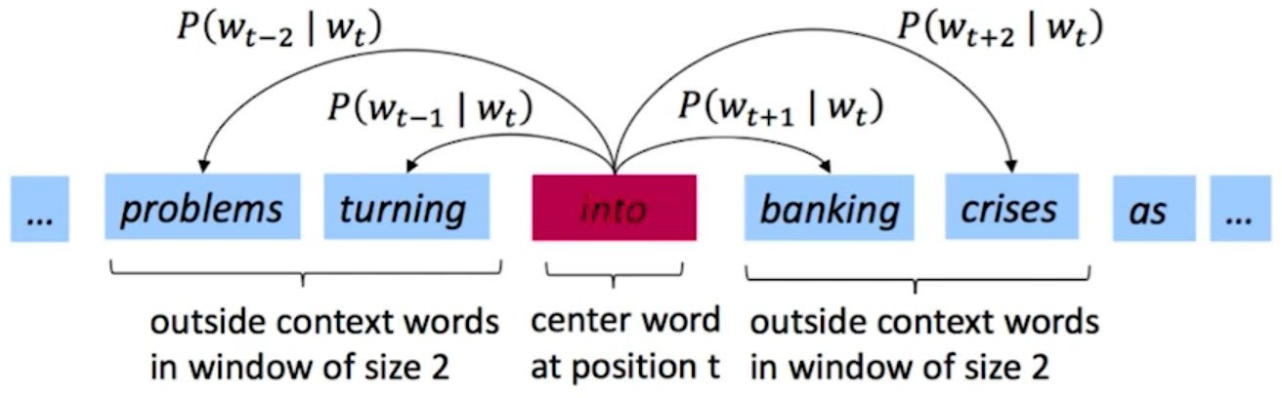
Word2Vec
“You shall know a word by the company it keeps.” – J.R. Firth
Going through text corpus by sliding windows

Slide 14
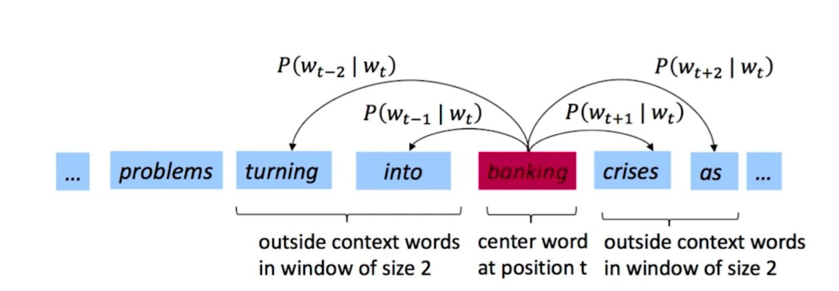
Word2Vec
“You shall know a word by the company it keeps.” – J.R. Firth
Going through text corpus by sliding windows

Slide 15
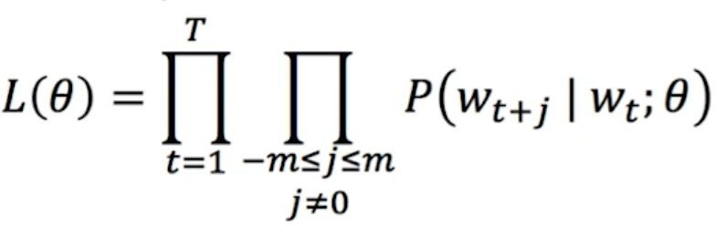
Word2Vec objective function
We want to maximize probability of context words given the center word (log-likelihood):

Slide 16
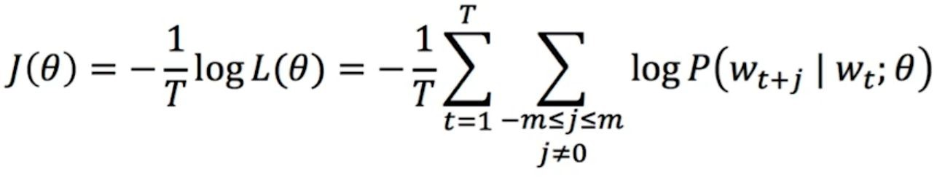
Word2Vec objective function
OR we want to minimize negative log-likelihood:

Slide 17
Word2Vec objective function
OR we want to minimize negative log-likelihood:
How to calculate P(w_{t} ₊n | w _{t} , 𝛳) ?

Slide 18
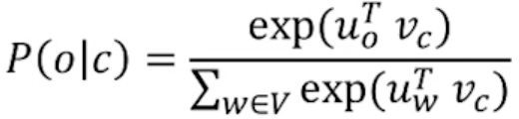
Word2Vec objective function
Given a center word c and a context word o:
u is a context word vector
v is a center word vector
“Scalar product between me and my neighbour must be as big as possible”

Slide 19
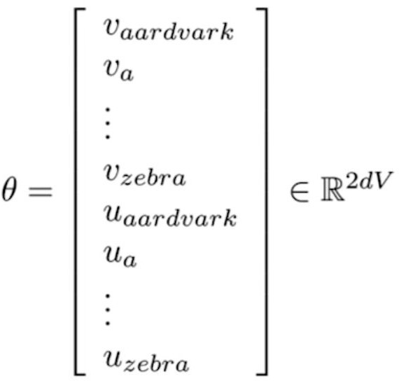
Word2Vec
𝛳 (vector matrices)

Slide 20
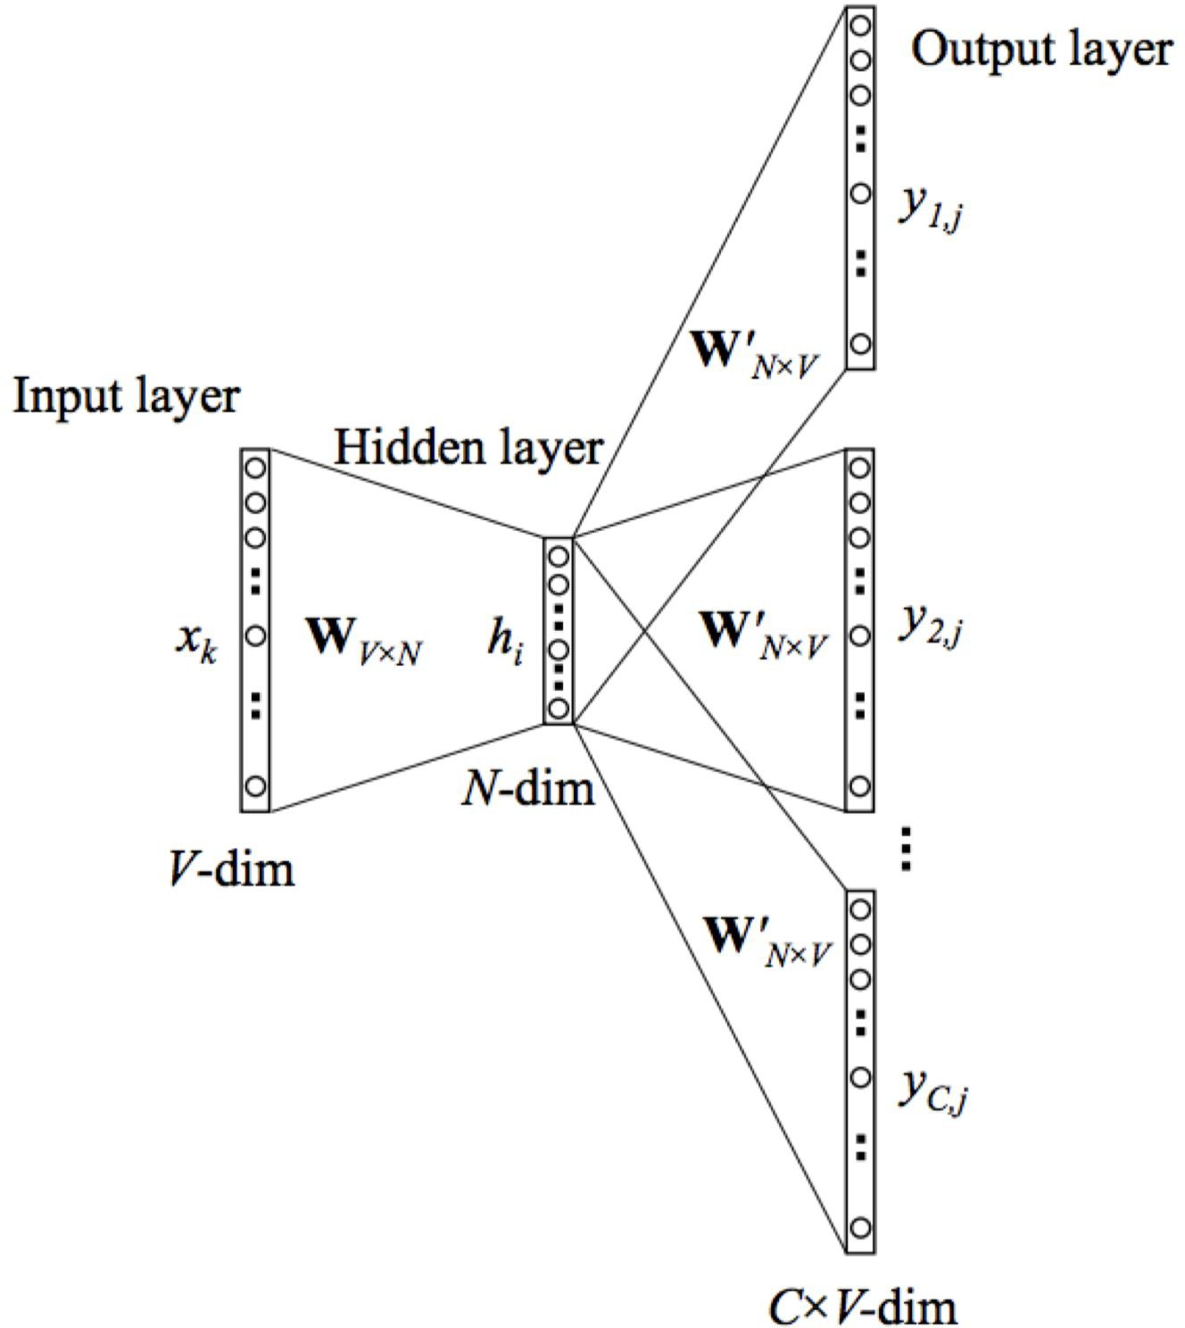
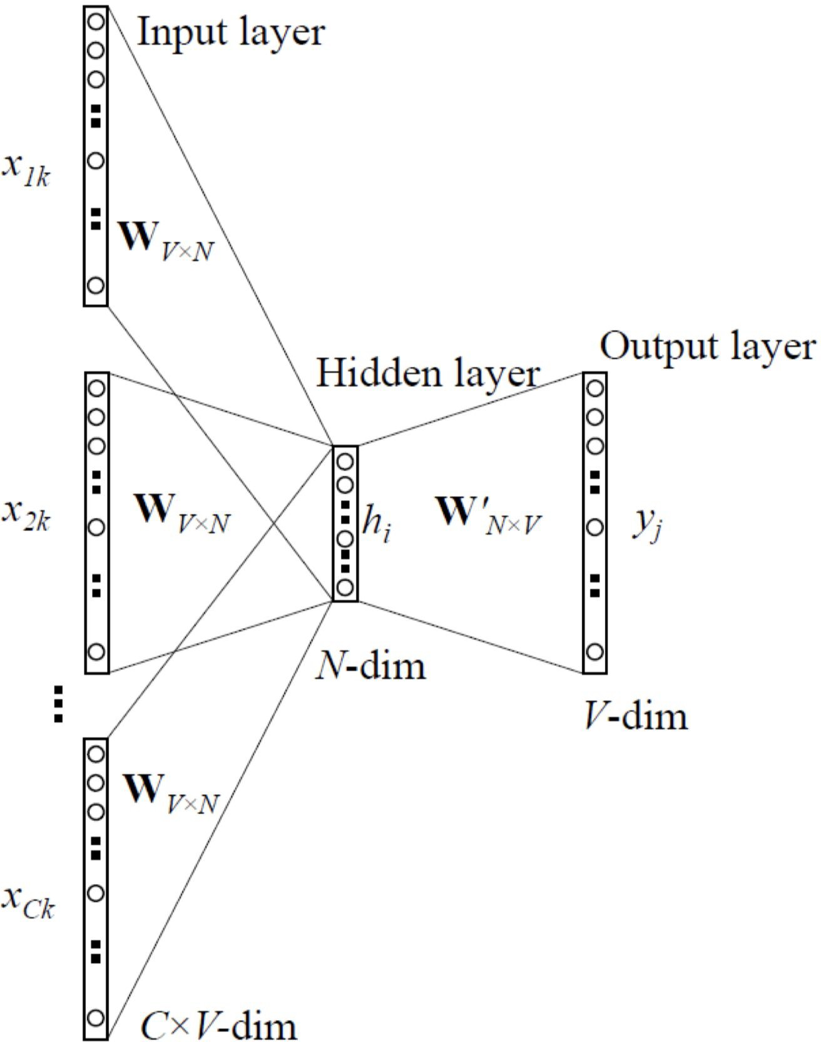
Word2Vec
Skip-gram
CBOW

Slide 21
Word2Vec
Problem:
Still big sum to compute

Slide 22
Word2Vec
Problem:
Still big sum to compute
Possible solutions:
Hierarchical softmax
Negative sampling (calculate for some random words)

Slide 23
Word2Vec vs SVD
Word2Vec with negative sampling ≈ matrix factorization
word
d
SVD
≈
✕
✕
w
word

Slide 24
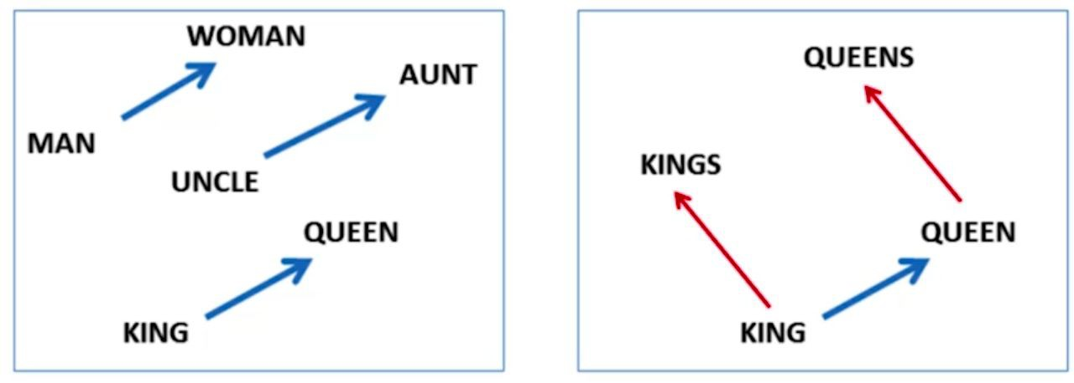
Word2Vec
v(king) - v(man) + v(woman) ≈ v(queen)

Slide 25
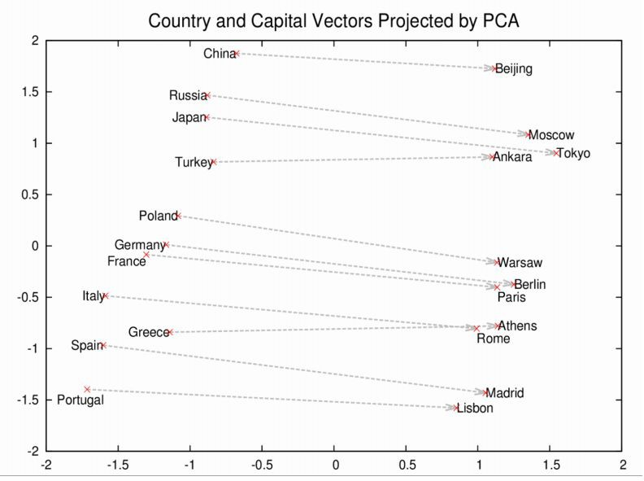

Slide 26
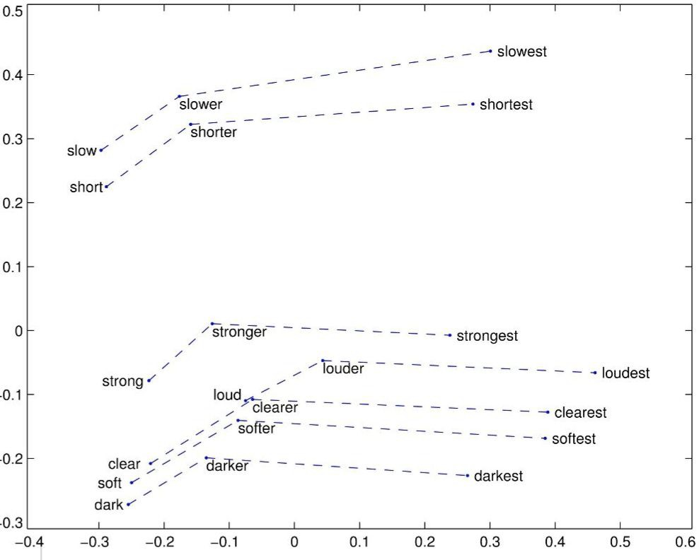

Slide 27
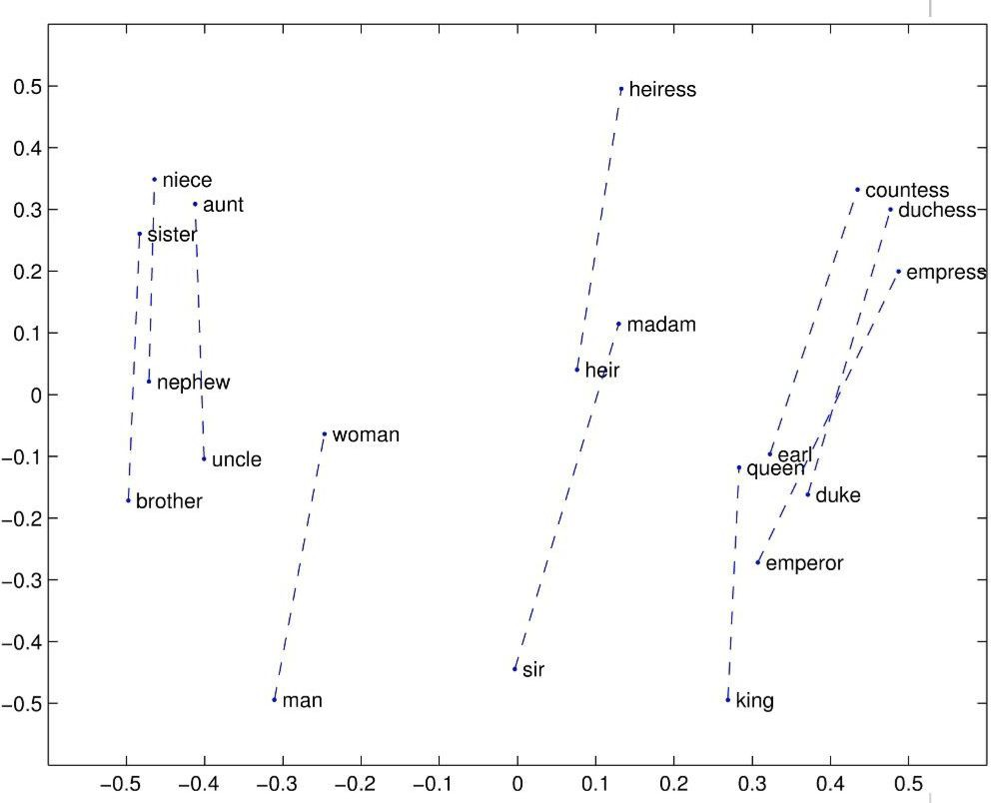

Slide 28
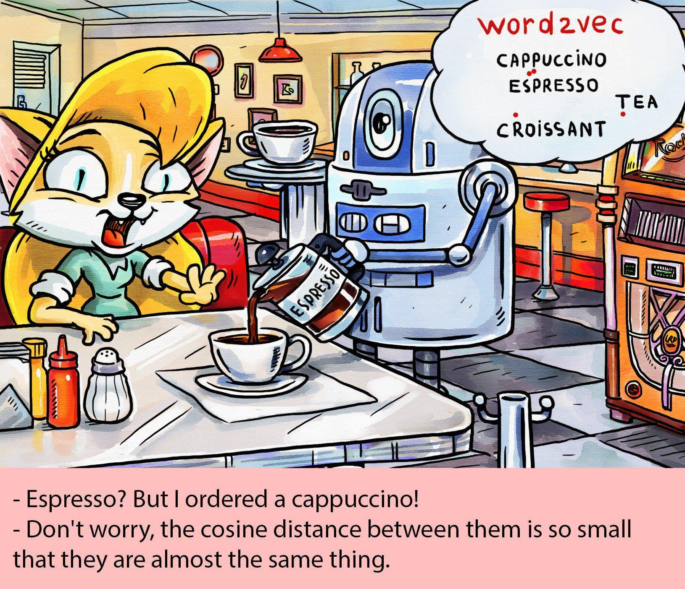

Slide 29
GloVe (Global Vectors)
Uses information about frequency of words and phrases in the text to improve training of embeddings for rare words.

Slide 30
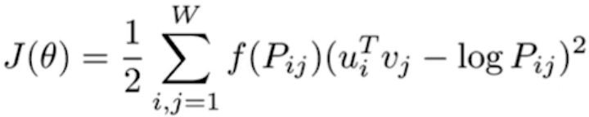
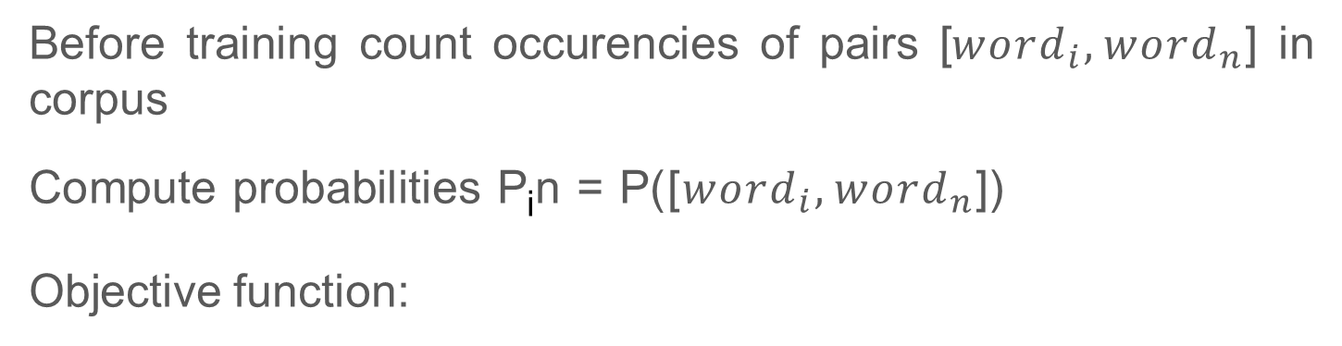
GloVe (Global Vectors)
Before training count occurencies of pairs [${word}_{i}, {word}_{n}$] in corpus
Compute probabilities P_{i}n = P([${word}_{i}, {word}_{n}$]) Objective function:

Slide 31
GloVe (Global Vectors)
Before training count occurencies of pairs [${word}_{i}, {word}_{n}$] in corpus
Compute probabilities P_{i}n = P([${word}_{i}, {word}_{n}$]) Objective function:
Closely related to co-occurence matrix
Close to the idea of factorizing co-occurence matrix (LSA)
Discount factor for rare words

Slide 32
FastText
Divide word into bag of n-grams: apple = <ap, ppl, ple, le>
Compute vector for each n-gram
Vector for a word = sum of vectors for word n-grams

Slide 33
FastText
Divide word into bag of n-grams: apple = <ap, ppl, ple, le>
Compute vector for each n-gram
Vector for a word = sum of vectors for word n-grams
Advantages:
Reasonable embeddings for rare words and words with mistakes
Model is the same as before, we can even use model trained on words to train it further on n-grams!

Slide 34
Sentence embeddings
Yeah, really, why not?

Slide 35
Sentence embeddings
What we did before:
Predict context using word
What we’ll do now:
Predict binary ordering of sentences (does this sentence go next or before?)
Can this sentence be the next or not? (Next sentence classifier)
Conjunction prediction

Slide 36
Sentence embeddings
Order classification
Next sentence classification
Conjunction classification
Sentence encoder
Sentence encoder
- - -
Sentence 1
Sentence 2

Slide 37
Finally...
Okay, that’s great, but why do we actually need embeddings?

Slide 38
Use embedding
When you have small text data for your task
Output (class, ex. genre, emotion)
Neural network
pre-trained
Embeddings
I
have
a cat UNK

Slide 39
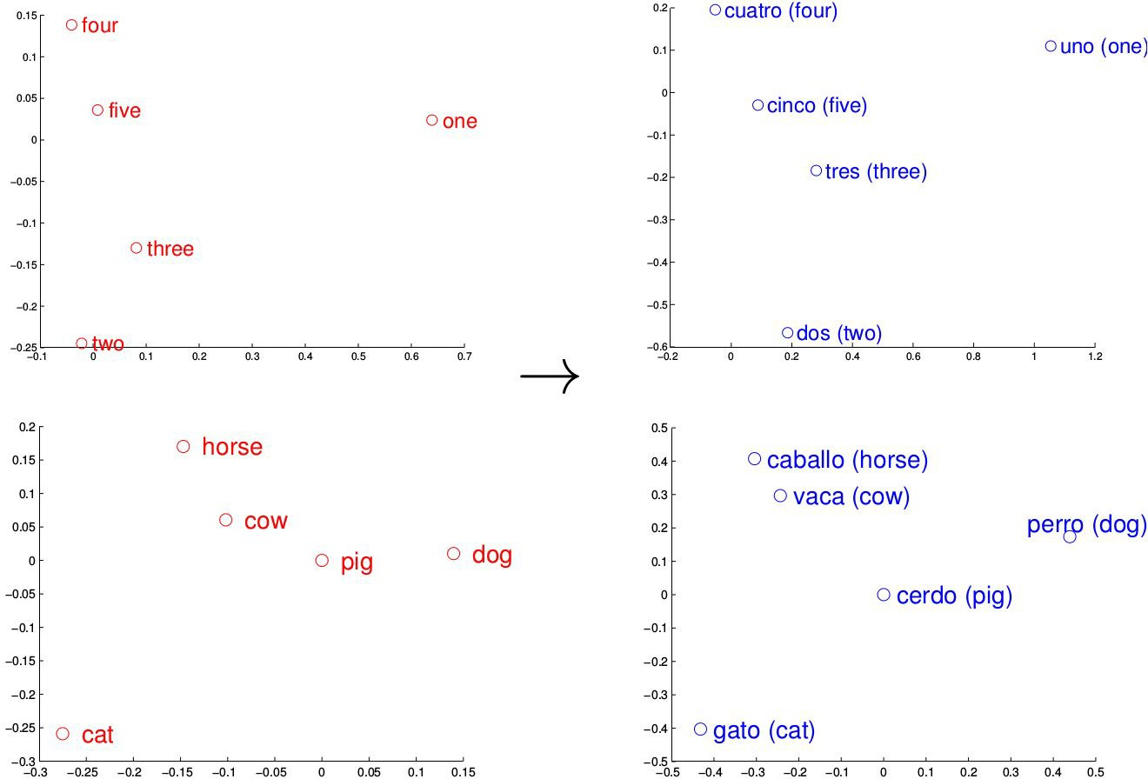
Language similarities
Use embedding
train embeddings for english
find mapping f() from english to spanish
get new english word -- use f() to compute translation!

Slide 40
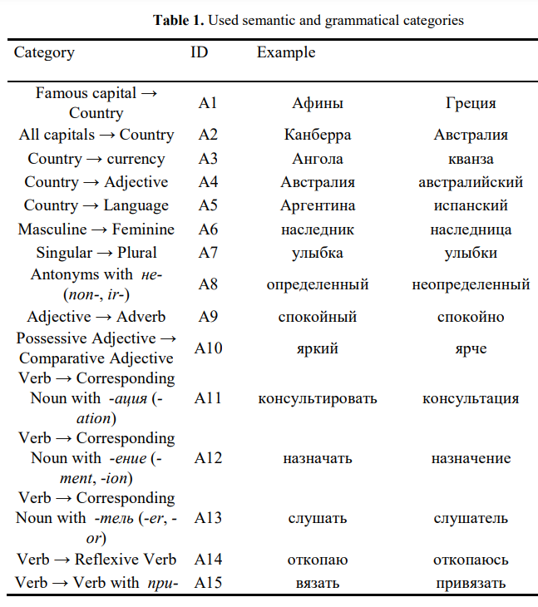
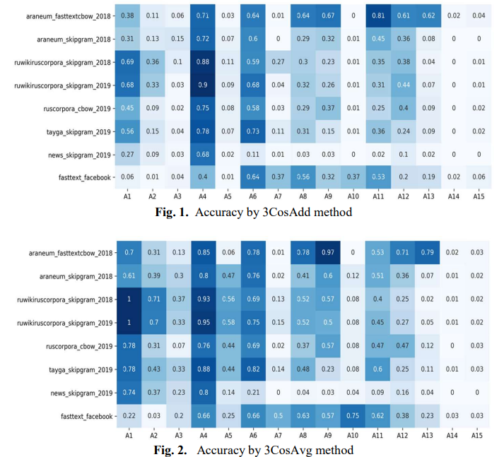
But does it work?
https://publications.hse.ru/pubs/share/direct/410001173.pdf

Slide 41
Masked language modeling (MLM) — generalization of classic language modeling.
Idea:
Predict any word in the text rather than only next one.

Slide 42
Masked language modeling (MLM) — generalization of classic language modeling.
Idea:
Predict any word in the text rather than only next one.
Yesterday we watched a great movie in the cinema.

Slide 43
Masked language modeling (MLM) — generalization of classic language modeling.
Idea:
Predict any word in the text rather than only next one.
Yesterday we watched a great movie in the cinema.
[MASK]
[MASK]

Slide 44
Masked language modeling (MLM) — generalization of classic language modeling.
Idea:
Predict any word in the text rather than only next one.
NEURAL NETWORK
Yesterday we watched a great movie in the cinema.
[MASK]
[MASK]

Slide 45
Masked language modeling (MLM) — generalization of classic language modeling.
Idea:
Predict any word in the text rather than only next one.
watched
movie
NEURAL NETWORK
Yesterday we watched a great movie in the cinema.
[MASK]
[MASK]

Slide 46
MLM vs ordinary language modeling
Represent next token prediction using MLM:

Slide 47
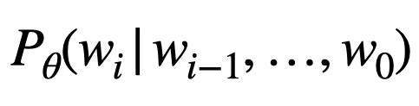
MLM vs ordinary language modeling
Represent next token prediction using MLM:
cinema
NEURAL NETWORK
=
We watched a movie in the cinema.
[MASK]
Mask last token in the sequence!

Slide 48


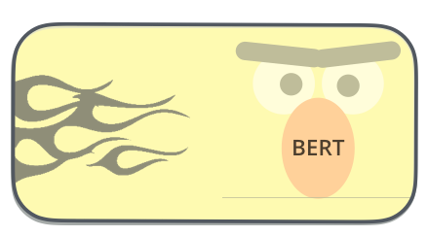
BERT — Bidirectional Encoder Representations from Transformers
Masked
Language Modeling
+
+
=

Slide 49
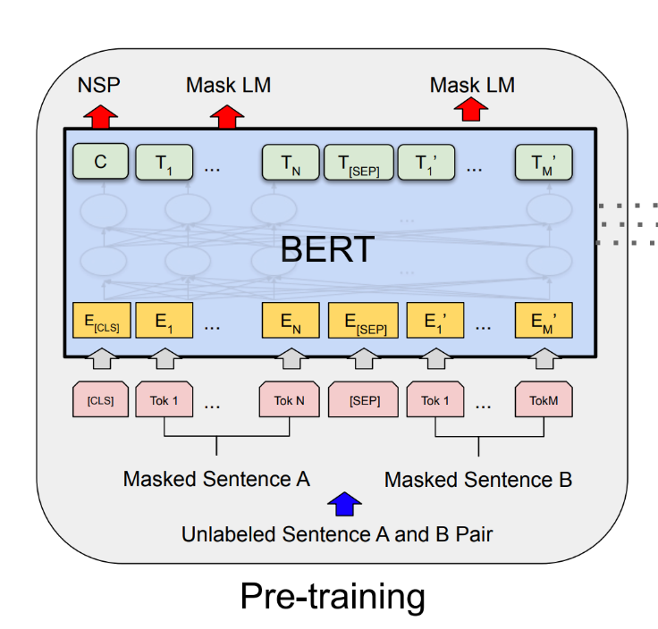
Well, not quite …
2 tasks on pre-train stage:
MLM (Masked Language Modeling)
NSP (Next Sentence Prediction)*
https://arxiv.org/pdf/1810.04805.pdf

Slide 50
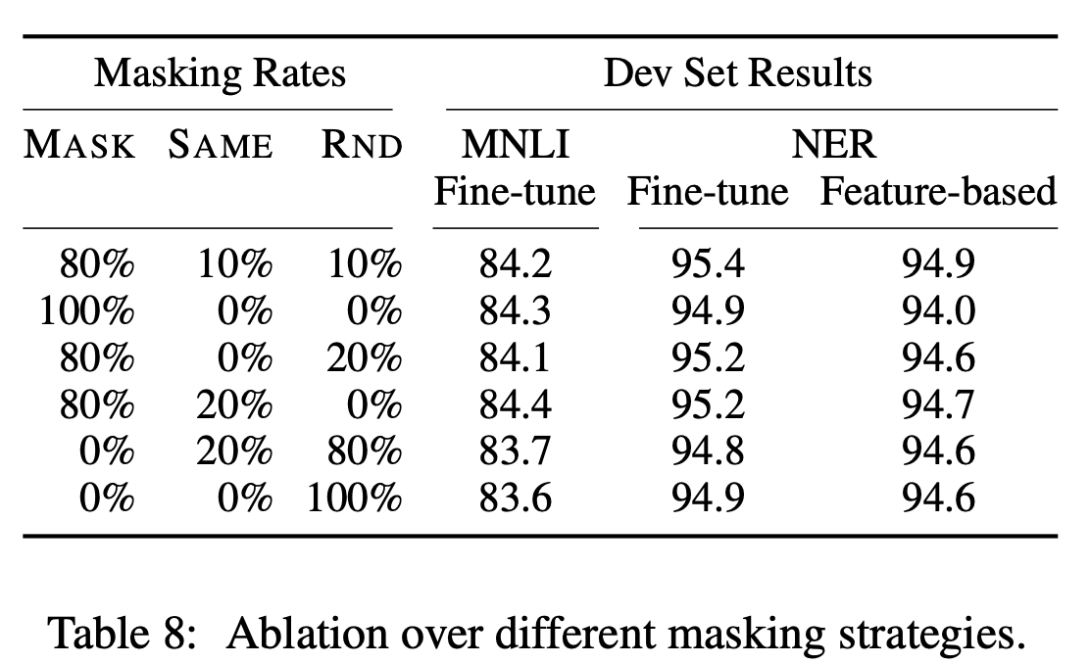
How to choose masking for MLM?
Details:
Randomly choose 15% from sentence tokens
80% change to [MASK]
10% change to random token from vocabulary
10% don’t change (and still train to predict it)
We want to get good representation for all tokens and not only [MASK].
On fine-tuning stage model won’t have [MASK]!
https://arxiv.org/pdf/1810.04805.pdf

Slide 51
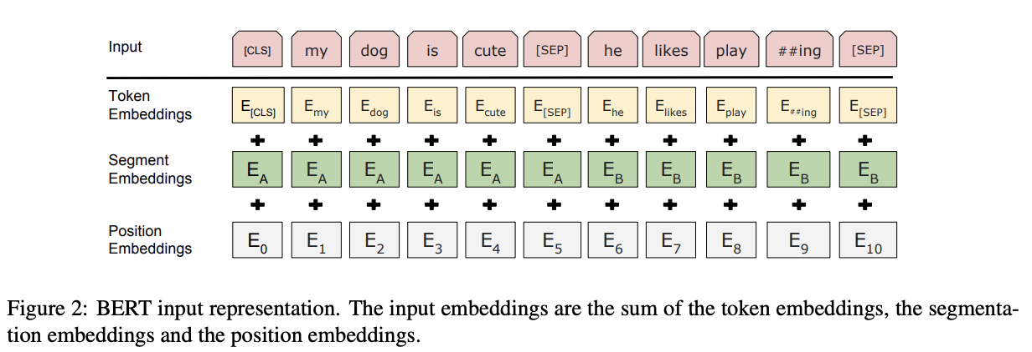
BERT has 3 types of embeddings
https://arxiv.org/pdf/1810.04805.pdf

Slide 52
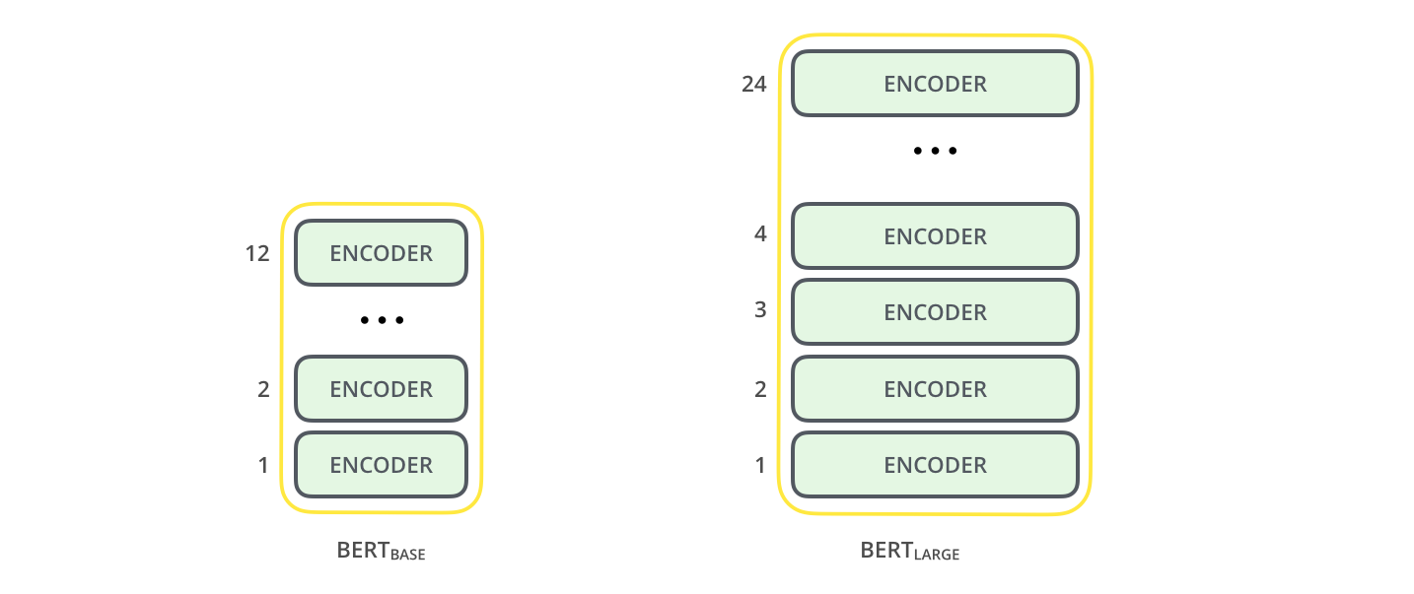
More details
2 configurations:
BERT-base: L=12, H=768, A=12, Total Parameters=110M
BERT-large: L=24, H=1024, A=16, Total Parameters=340M
Data:
BookCorpus (800 млн. слов)
English Wikipedia (2,5 млн. слов)
Max sentence length — 512 tokens
“Pretrain once, finetune many times”
https://iq.opengenus.org/bert-base-vs-bert-large/

Slide 53
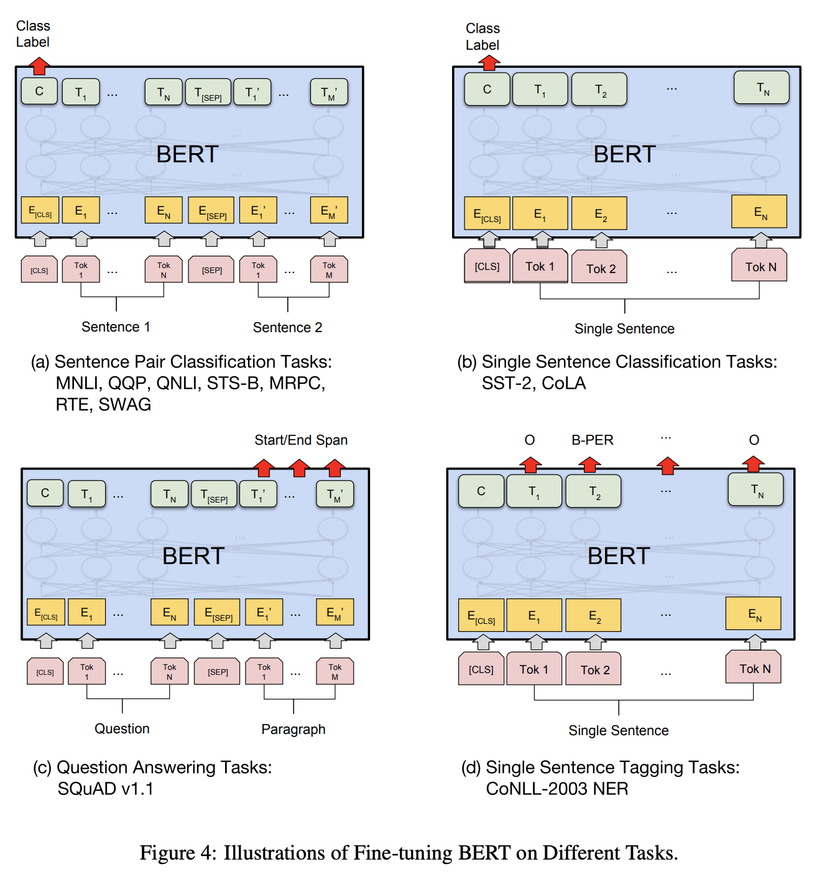
BERT — general framework for solving most of NLU problems
https://arxiv.org/pdf/1810.04805.pdf

Slide 54
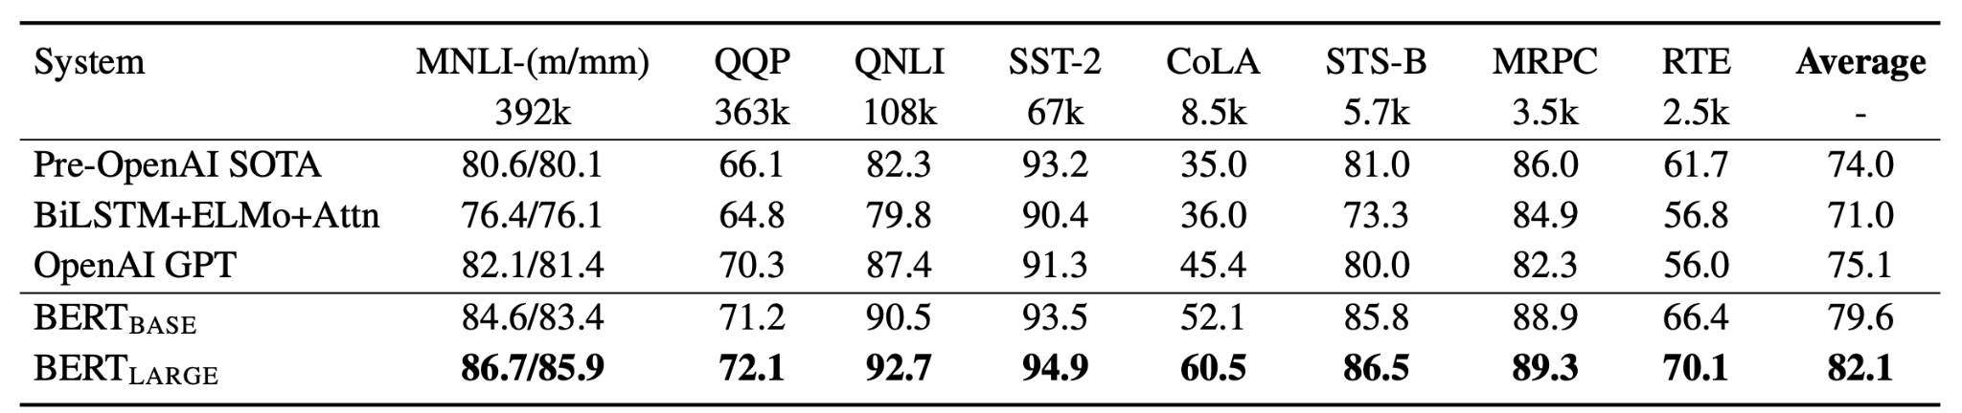
Results
Better performance on GLUE compared to GPT
https://arxiv.org/pdf/1810.04805.pdf

Slide 55
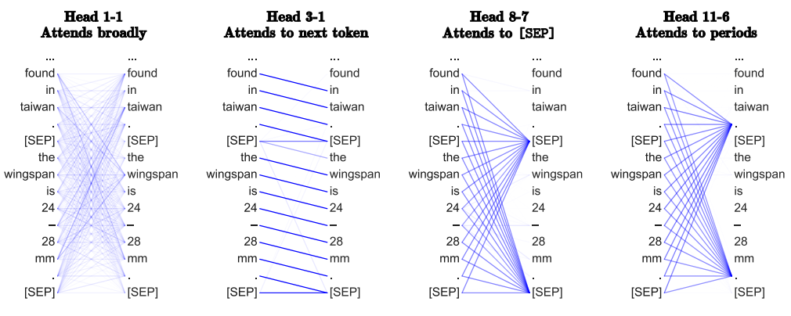
What does it look at?
https://arxiv.org/pdf/1906.04341v1

Slide 56
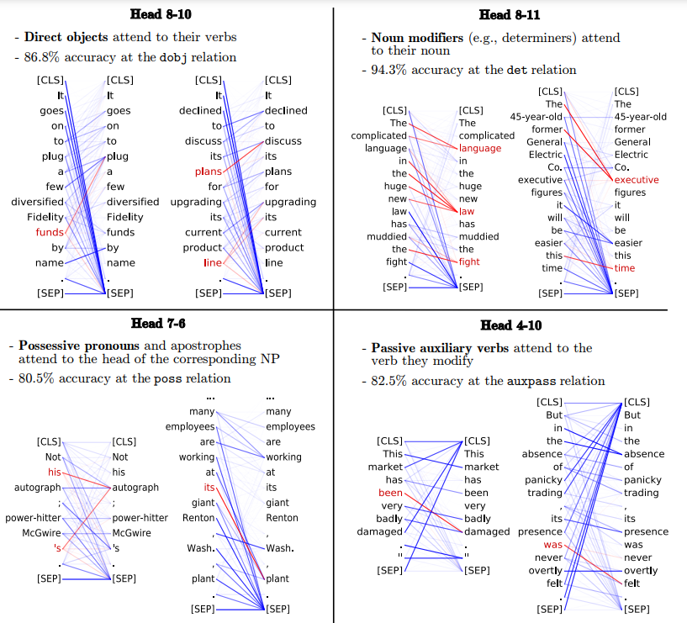
We haven’t been training for this!
https://arxiv.org/pdf/1906.04341v1

Slide 57
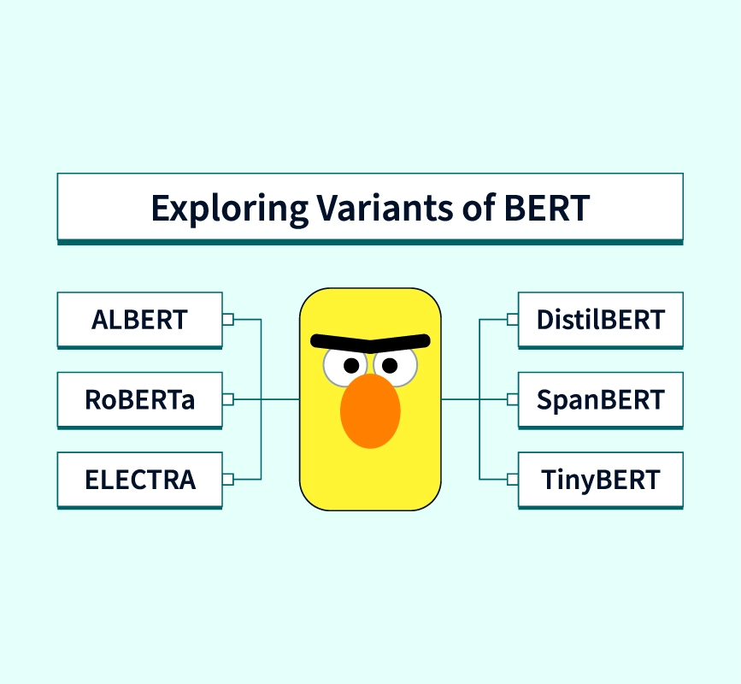
What was after BERT?
There are a lot of extensions and improvements of BERT:
RoBERTa
DeBERTa
DistilBERT
ALBERT
ELECTRA
…
https://www.scaler.com/topics/nlp/bert-variants/

Slide 58
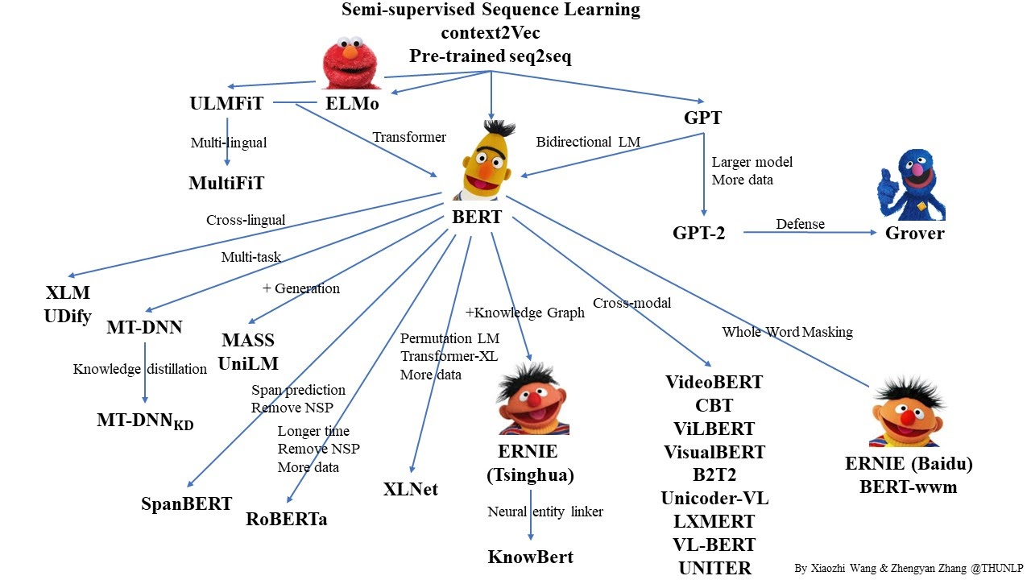
What was after BERT?

Slide 59
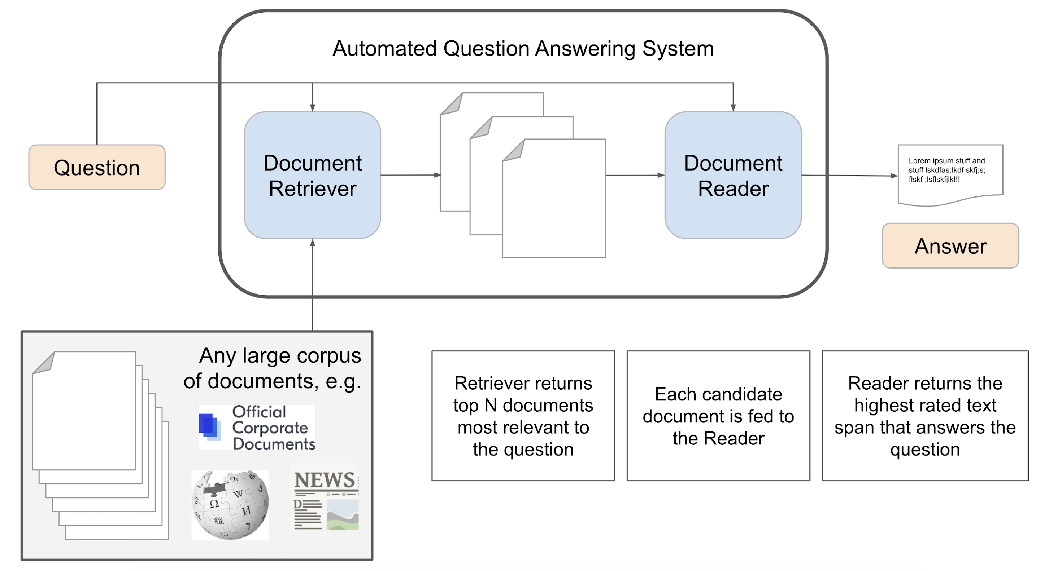
Let’s code QA on Wikipedia!

Slide 60
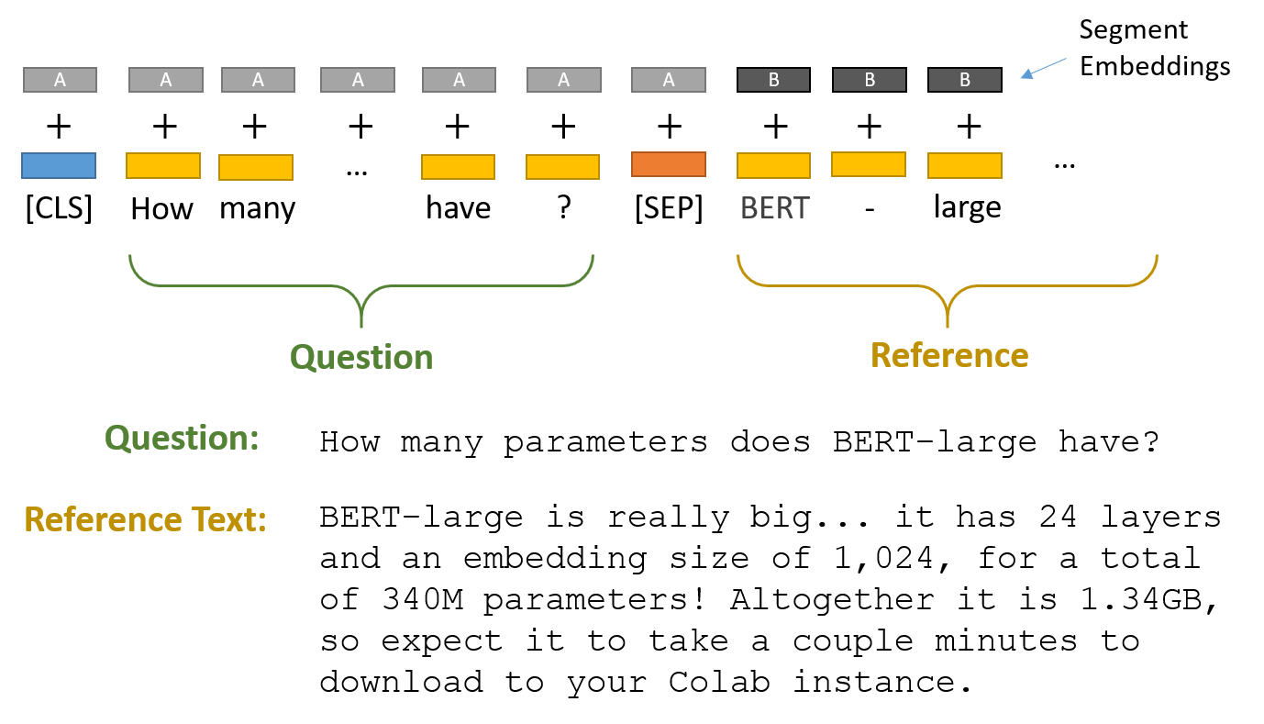
Input

Slide 61
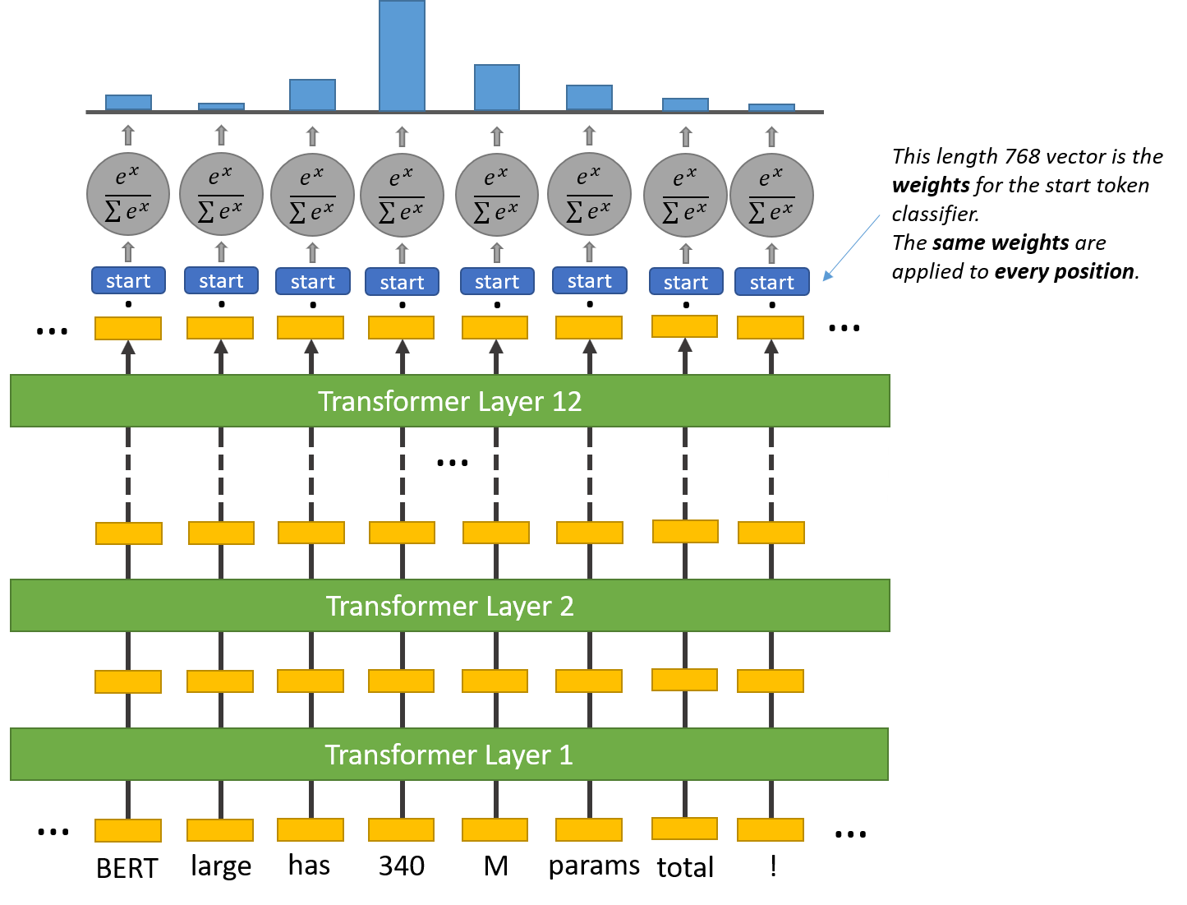
Start

Slide 62
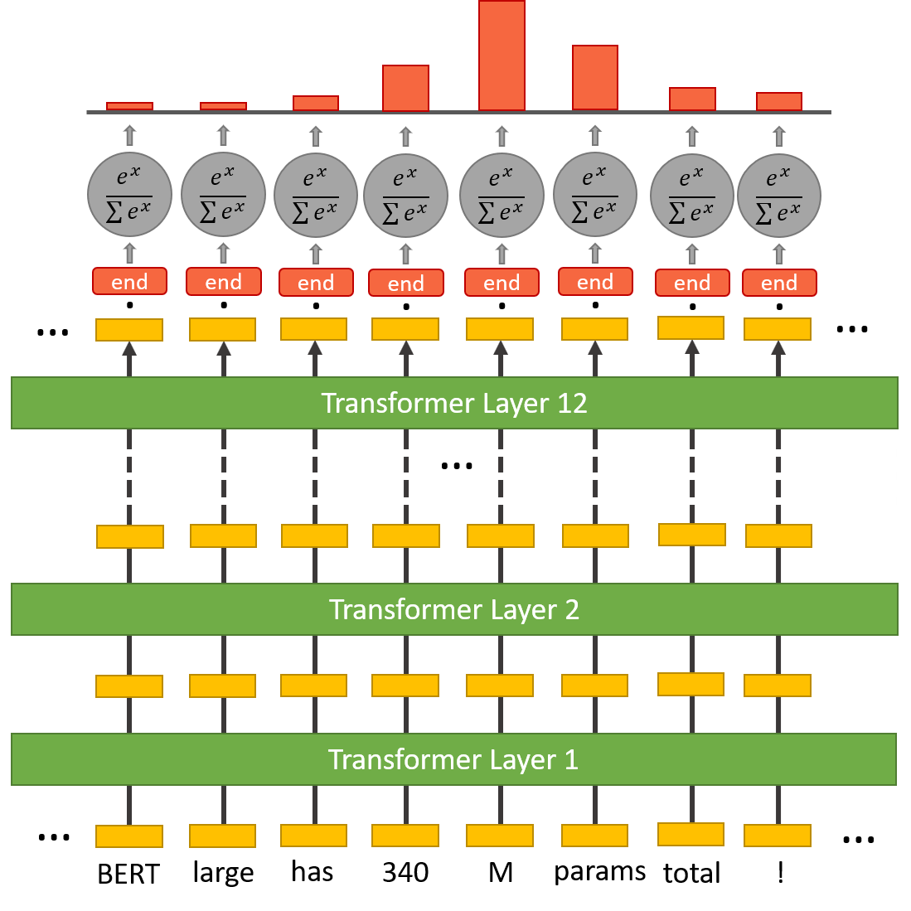
End

Slide 63
Details
Model accepts only 520 at once, so split article into chunks
torch.argmax() to select best chunk
Select start and end tokens with largest logits
https://qa.fastforwardlabs.com/pytorch/hugging%20face/wikipedia/bert/transformers/2020/05/19/Getting_Started_with_QA.html

Slide 64
Details
Model accepts only 520 at once, so split article into chunks
torch.argmax() to select best chunk
Problems:
Answer depends on the selected article
What if there is no answer in the article?
Chunking method could split sentence in wrong place
Questions that don’t have answer?

Slide 65
Can we do better?
Use SQuAD2.0 dev set
Generate more robust predictions
Choose start and end tokens wisely
Use null threshold
Return probability of the answer
…
https://qa.fastforwardlabs.com/no%20answer/null%20threshold/bert/distilbert/exact%20match/f1/robust%20predictions/2020/06/09/Evaluating_BERT_on_SQuAD.html#Using-the-null-threshold

Slide 66

Thanks!

